Slide 1
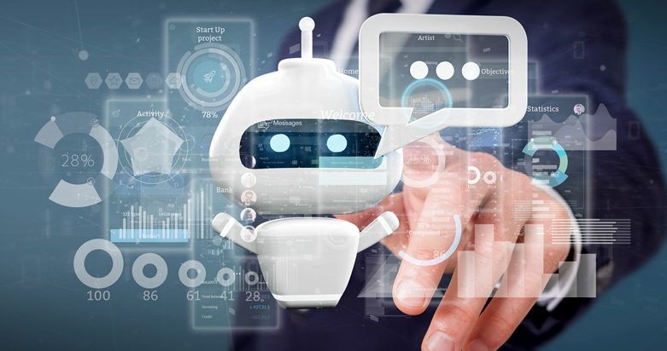
Health Crest
For you. For your family. For life.

Slide 2


Agenda
To develop a website, where users can diagnose their health at home and take precautions for any minor health issues they are facing in proper scientific approach and resolve those issues.
For any major health issue, a user can access our website to get information about the hospitals/clinics and specialized doctors working there, so users can appoint and consult doctor in the most effective and efficient way possible.

Slide 3



Introduction
“Health Crest”,
A highly interactive AI based website with in-built chat bot which helps the user to provide accurate information, based on the inputs given by user.
The in-built chat bot helps the user by providing specific information in a most effective and user-friendly way.

Slide 4
Problem statement
Normally, users are not aware about the treatment or symptoms regarding the specific disease or health issue. Potential risks of self-medication practices include: incorrect self-diagnosis, delays in seeking medical advice when needed, infrequent but severe adverse reactions, dangerous drug interactions, incorrect manner of administration, incorrect dosage, incorrect choice of therapy, masking of a severe disease and risk of dependence and abuse.
But for small problems, users have to go personally to the hospital for check-ups which is time consuming, hence, most of the users neglect their health, due to which health issues tend to grow and becomes severe, sometimes in-operable.
Most of the time people are unaware of hospitals and specialized doctors that hospital has to provide, due to which people waste their valuable time.

Slide 5
SOLUTION
We are developing a IA based highly interactive website “Health Crest”, which takes minor health issues faced by the users as input and provides appropriate precautions and medications based on “think ”. Due to this people can easily get medicated in their home, without much time consumption. If user’s health issue is severely ill, the website will provide information about the treatment they can get for that issue, hospitals will provide those treatment and specialized doctors.
When user selects a hospital and specialized doctor of that hospital, the doctor receives a basic report of the user, which contains user’s personal details and health history. From this report, doctor gets an idea about the user and his/her current health state. With this, he can plan the course of treatment and medication and offers the user in advance.
Health Crest provides user, Solution for their health issues in a interactive, informative and effective way, without much time consumption.

Slide 6
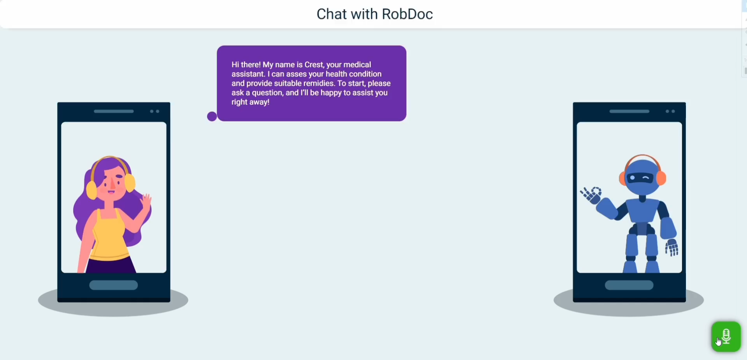

Slide 7
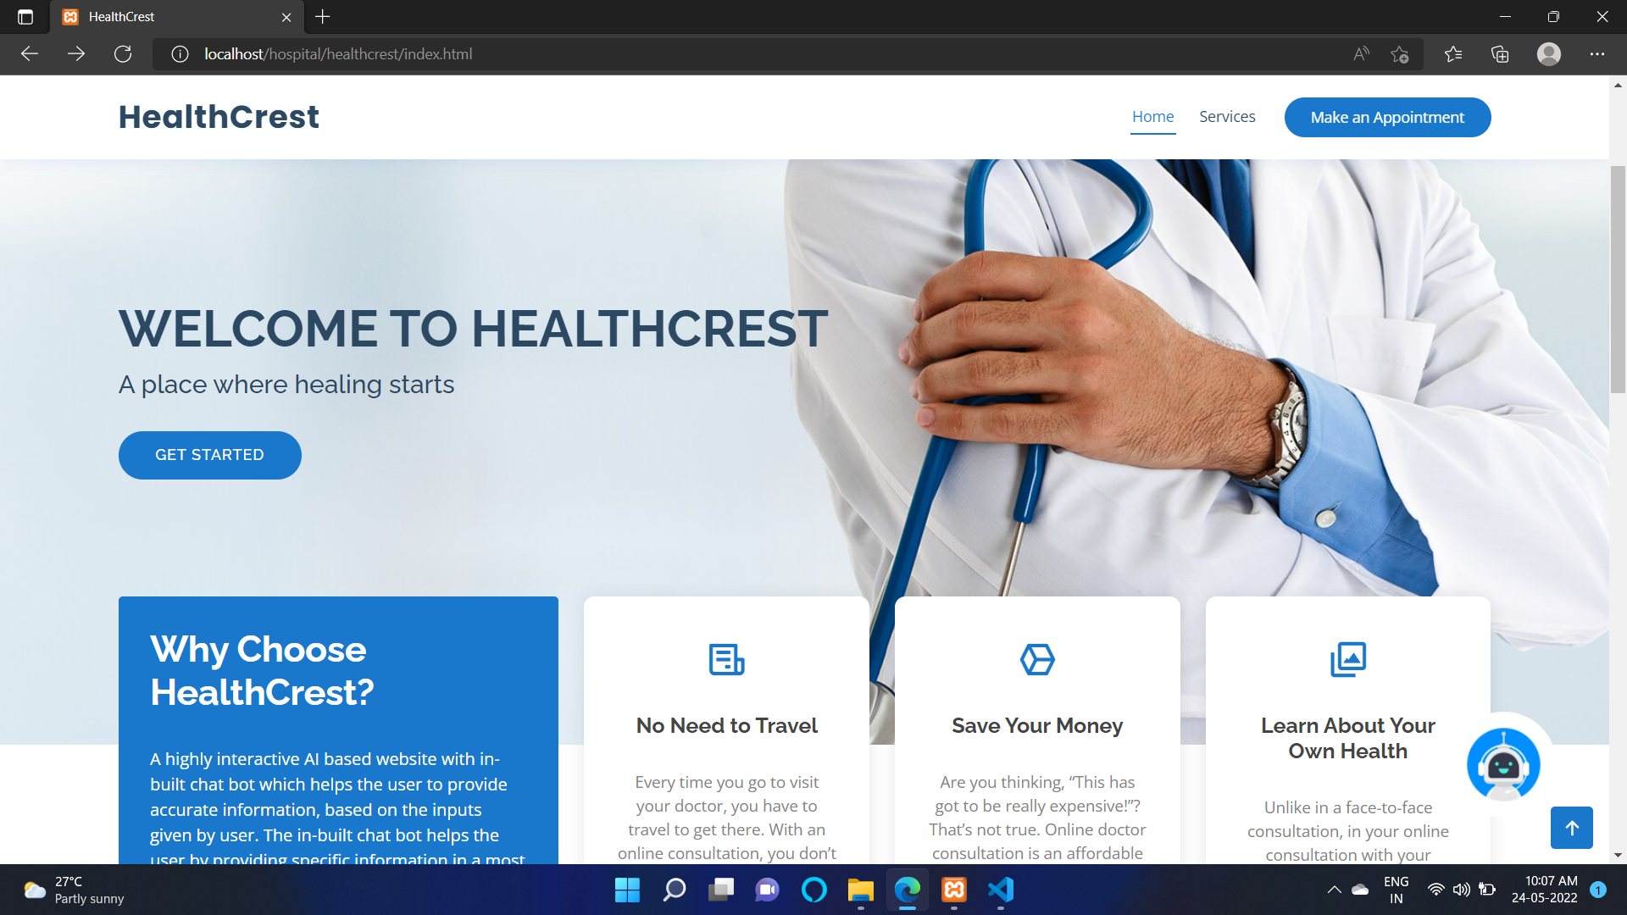

Slide 8
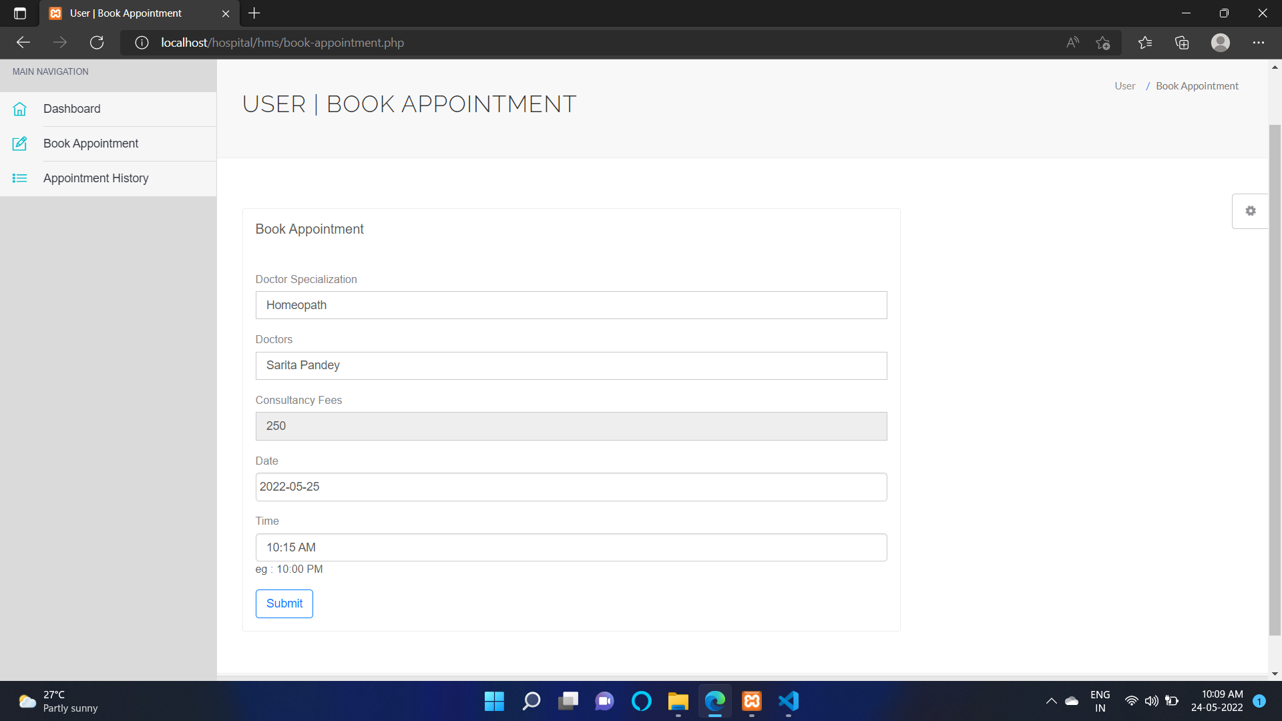

Slide 9
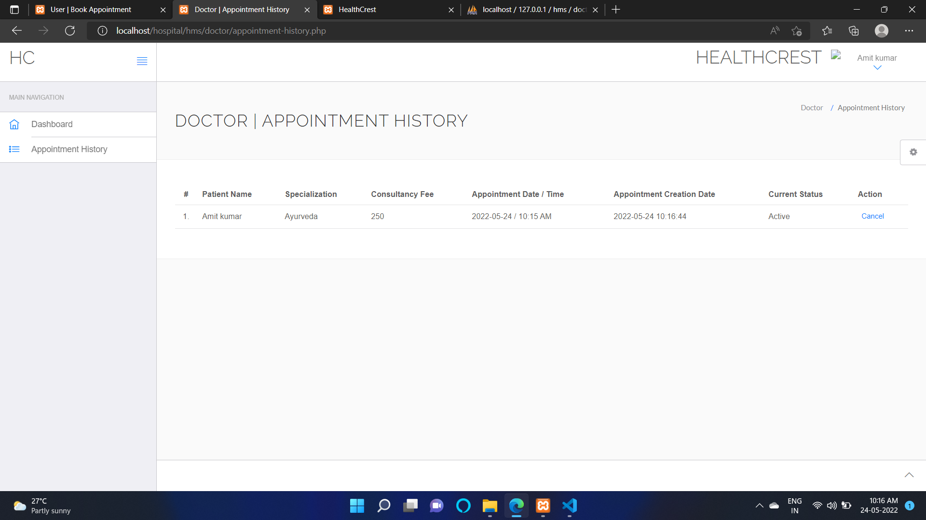

Slide 10
Use-Cases
Detect Diseases Before Visiting a Doctor: To offer services with ease and accuracy, AI-powered chatbots can provide patients with information. Patients can share their symptoms with the chatbot and the chatbot can analyze those symptoms and provide information or actions to take. If the issue is serious, the chatbot can escalate to a human representative to schedule an appointment or request emergency services
Complete Administrative Tasks and Schedule Appointments: Chatbots can handle any number of requests, schedule appointments, and resolve simple questions. Chatbots can also send notifications to prompt patients about their appointments and ask about their health to gather critical information for doctors.
Provide Secure Access to Medical Records: Medical data increases every year and the industry is failing to cope with the rate at which medical data (patient records, prescriptions, MHR, clinical research, data from health-based personal tech) is generated. Accessing these Electronic Medical Records (EMR) from a web portal can be difficult even for a medical practitioner as they need to be trained on how to use the portal. Instead, having a chatbot makes the job of extracting records quick and easy all while staying secure.
Reduced Waiting Times: Chatbots in the healthcare system prevent long hospital queues by providing patients with instant answers.
Massive Reduction Care Costs: Chatbots help to significantly reduce business overheads of manning the desk or call centers.
Timely Medical Advice: Care chatbots help provide instant information, which can save a person’s life at the time of a crisis.Ease the burden on doctors: It is nearly impossible for doctors to attend to all patients on a tight schedule, whereas medical chatbots are accessible 24*7.
Anonymity: AI-powered medical chat is designed to maintain an individual’s anonymity which is beneficial for sensitive cases.Timely monitoring: A healthcare chatbot can help monitor a patient’s health, suggest treatment, or give follow-up reminders.
Real-Time Interaction: Chatbot provides immediate responses and changes the response, depending on the input, just like real-time interaction with a doctor.
Scalability: Chatbots can seamlessly handle numerous customers without compromising the quality or adding to the cost.Patient satisfaction: A healthcare chatbot safely provides timely and intelligent solutions, which, in turn, increases patient satisfaction.

Slide 11
Technology Stack:
Artificial intelligence
Data science
Nlp
Html
Css
Javascript
Php
Python

